Slide 1
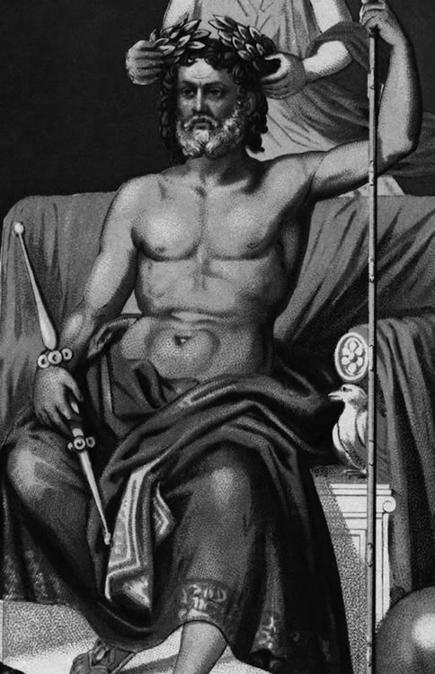
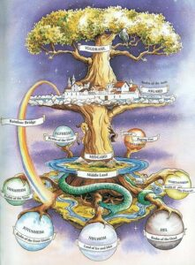
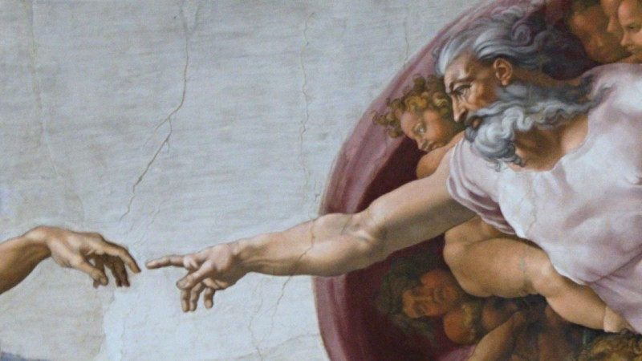
In the Beginning …
https://www.khanacademy.org/humanities/big-history-project/what-is-big-history/origin-stories/a/origin-story-greek
ThE Ancients’ views of the universe
https://surflegacy.net/yggdrasil/

Slide 2
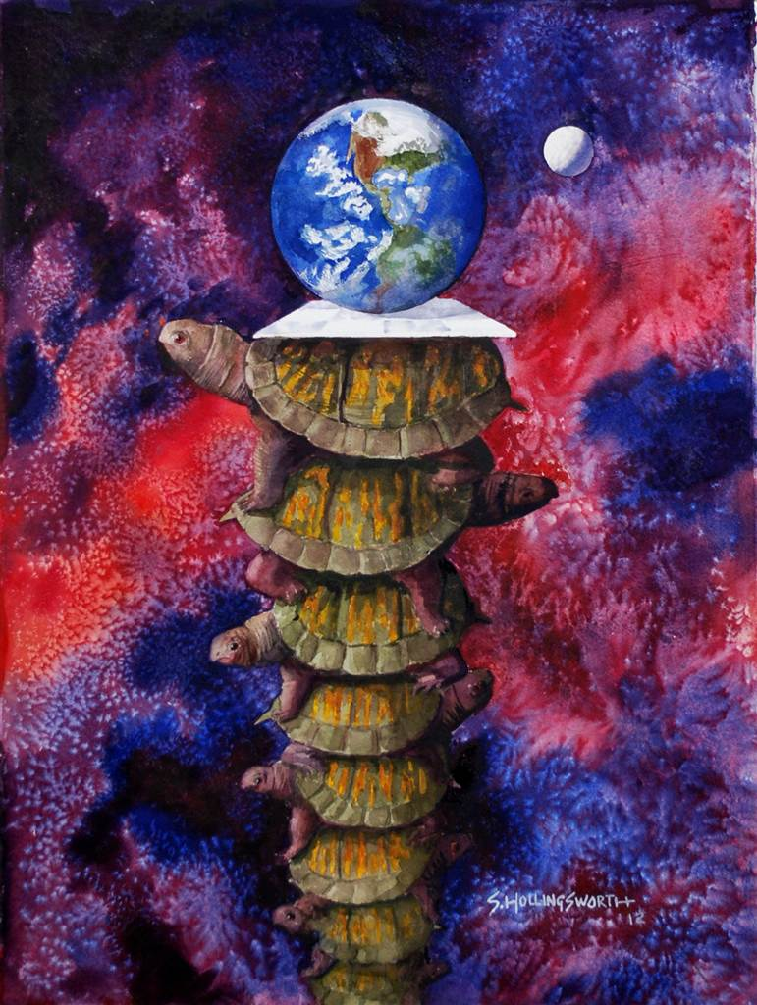
“… it’s turtles all the way down!”
From Stephen Hawking’s A Brief History of Time (1988):
A well-known scientist (some say it was the philosopher Bertrand Russell) once gave a public lecture on astronomy. He described how the Earth orbits around the sun and how the sun, in turn, orbits around the centre of a vast collection of stars called our galaxy.
At the end of the lecture, a little old lady at the back of the room got up and said: “What you have told us is rubbish. The world is really a flat plate supported on the back of a giant tortoise.”
The scientist gave a superior smile before replying, “What is the tortoise standing on?”
“You’re very clever, young man, very clever,” said the old lady. “But it’s turtles all the way down!”
See:
https://quoteinvestigator.com/2021/08/22/turtles-down/

Slide 3
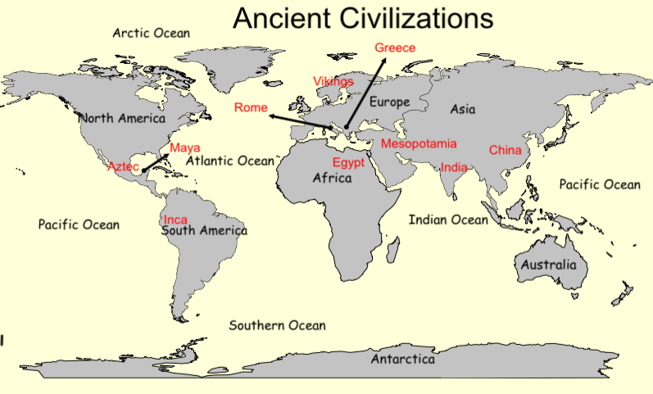
Where were the civilizations?

Slide 4
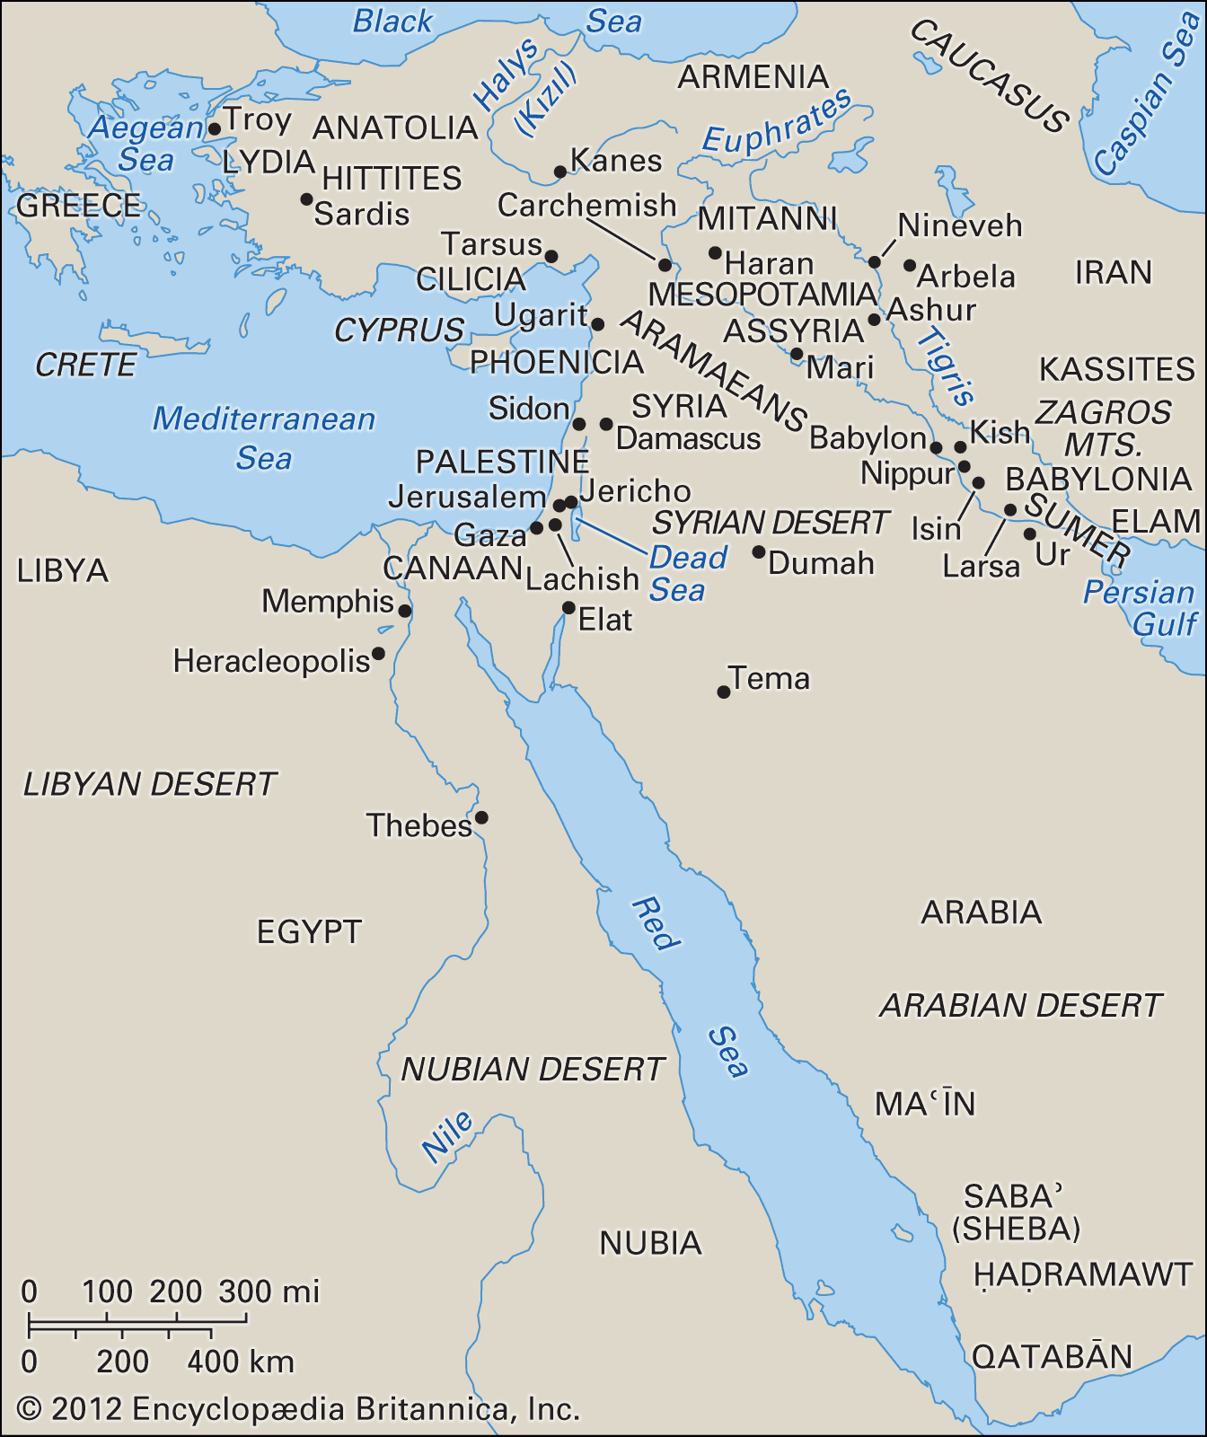
Ancient Middle East
Babylonians and Sumerians
Egyptians
Greeks

Slide 5
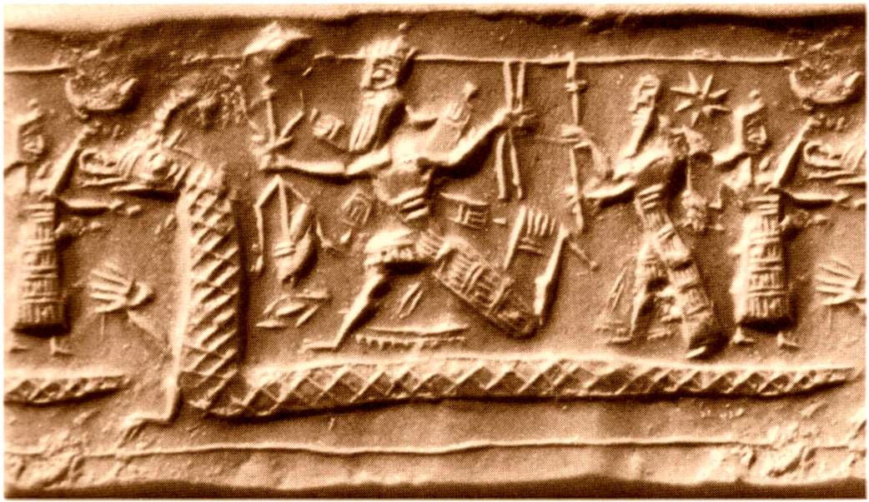
Mesopotamian Cosmology
(Babylonians and Sumerians):
Babylonians lived in Mesopotamia, a fertile plain between the Tigris and Euphrates rivers
Writing based on cuneiform (wedge-shaped) symbols written on wet clay tablets
The Babylonians believed in a three-tiered universe: the heavens, Earth, and the underworld.
They believed that celestial events, such as eclipses and planetary movements, held significance for earthly affairs.
The Enuma Elish, a Babylonian creation myth, tells the story of the gods' struggle to establish order in the universe.
Notes:
Believed the Earth to be a big circular plane surrounded by a river
beyond lies an impassable mountain barrier,
the whole thing resting on a cosmic sea.
No human may cross the river surrounding the Earth.
The mountains support the vault of heaven, which is made of a very strong metal.
There is a tunnel in the northern mountains that opens to the outer space, also connects two doors, in East and West.
The sun comes out through the eastern door,
travels below the metallic heavens
then exits through the western door;
he spends the nights in the tunnel.

Slide 6
Babylonian Creation Myth
Cosmic ocean Apsu mixed with chaos Tiamat and eventually generated life
“Tiamat felt her domain was too small and made war against the other gods. All but Marduk were afraid of her, so Marduk, after getting all the powers from the frightened gods, fought Tiamat. When Tiamat opened her mouth to swallow him he thrust a bag full with hurricane winds into her so that she swelled and, taking advantage of her indisposition, Marduk pierced her with his lance and killed her. Then he split Tiamat’s carcass making the lower half the earth and the upper the heavens. Finally Marduk mixed his own blood with the earth to make men for the service of the gods”
Babylonians observed stars and planets since 2200 BCE.
Beginnings of astrology.
Base 60 – sexagesimal system – 24 hr, 60 min/hr, 60 sec/min
(Why 24? - https://www.abc.net.au/science/articles/2011/11/15/3364432.htm but
how many finger joints do you have on one hand?
https://medium.com/@jothibasuofficial/why-there-are-24-hours-in-a-day-and-60-minutes-in-an-hour-b670879cbe99 )
https://www.physics.umd.edu/courses/Phys117/Liberati/Support/cosmology.pdf

Slide 7
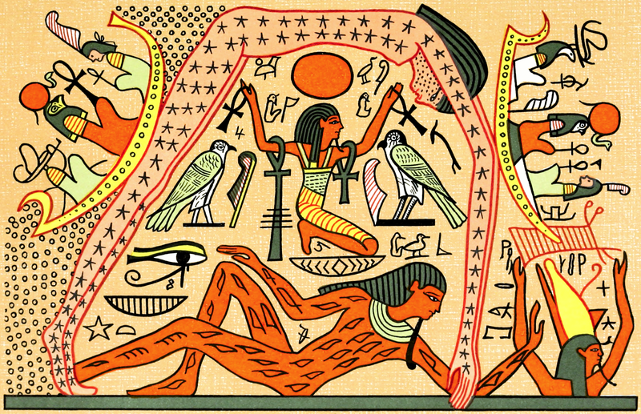
Ancient Egyptian Cosmology:
The Egyptians believed in a flat Earth, with the sky represented as a solid dome held up by the god Geb.
The Earth is a flat rectangle, longer from north to south; surface bulges slightly with the Nile as its center. On the south: a river in the sky supported by mountains.
They believed that the sun, moon, and stars traveled across the sky on the sun god Ra's solar barge.
The stars were suspended from the heavens by strong cables.
The Nile River was considered a representation of the Milky Way, and the afterlife was associated with the stars.

Slide 8
Egyptian Creation story
https://www.physics.umd.edu/courses/Phys117/Liberati/Support/cosmology.pdf
No unique story: In the beginning of the world,
Nuit, the goddess of the night, with her husband Sibu, the earth god.
One day, the god Shu grabed her and elevated her to the sky, despite the protests of Sibu.
Shu has no sympathy and freezes Sibu. He remains to this day,
his twisted pose generating the irregularities we see on the Earth’s surface.
Nuit is supported by her arms and legs, as the columns holding the sky.
The newly created world was divided into four houses, each dominated by a god.
Since the day of creation, Sibu has been clothed in verdure and generations of animals
prospered on his back.
After creation the gods teach the arts and sciences to the Egyptians.
Calendars – predict Nile floods.
365 day year. Corrected every 730 years with 6 months, returning in 1460 years.

Slide 9
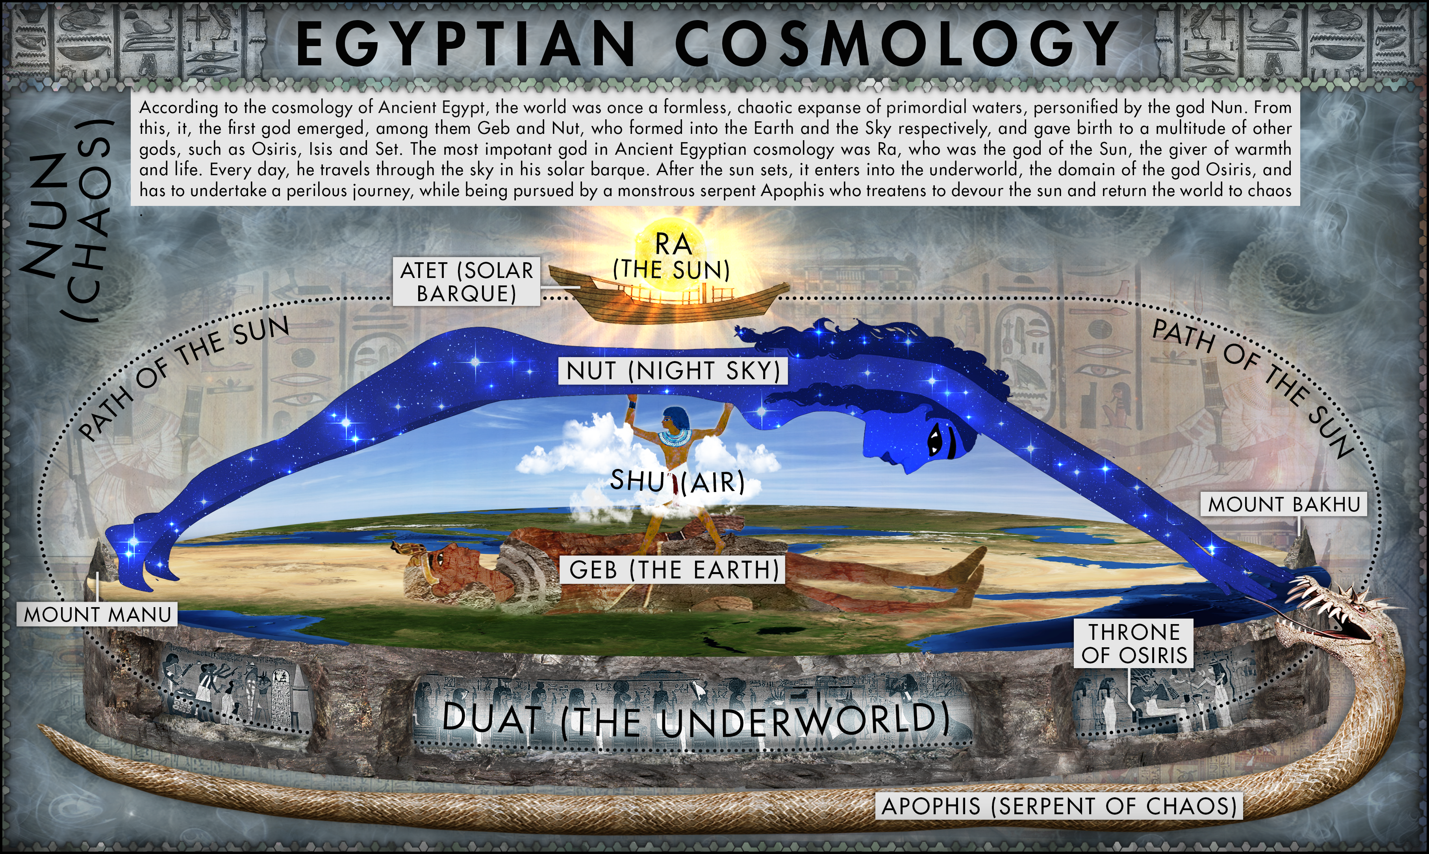
https://www.deviantart.com/jaysimons/art/Ancient-Egyptian-Cosmology-878264428

Slide 10
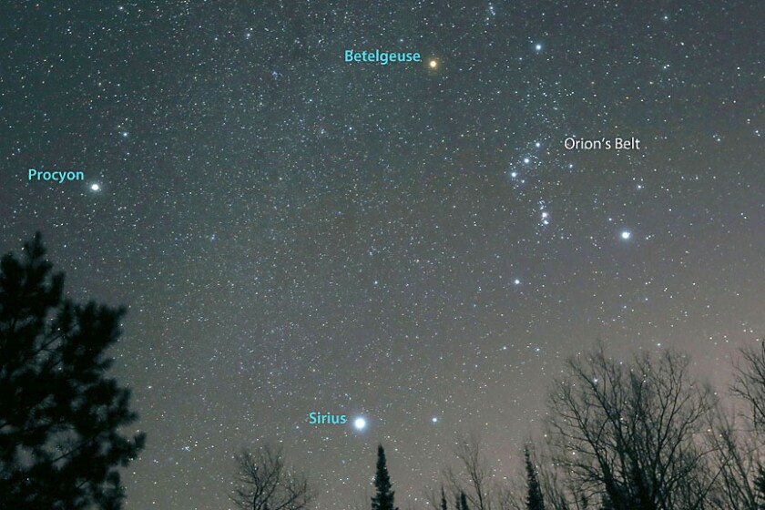
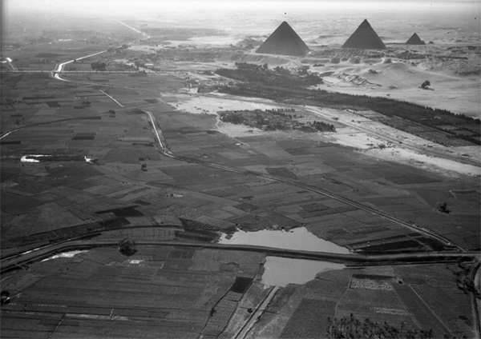
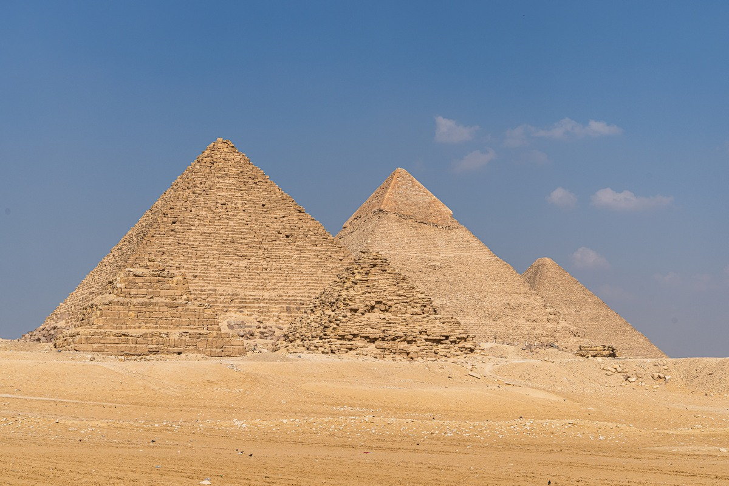
Great Pyramids
The Pyramid of Menkaure, the Pyramid of Khafre, and the Great Pyramid of Giza.
2500 BCE
Orion’s Belt?
https://eugene.kaspersky.com/2022/11/16/erosion-disintegration-conspirology-and-omg-views-the-pyramids-of-ancient-egypt/

Slide 11
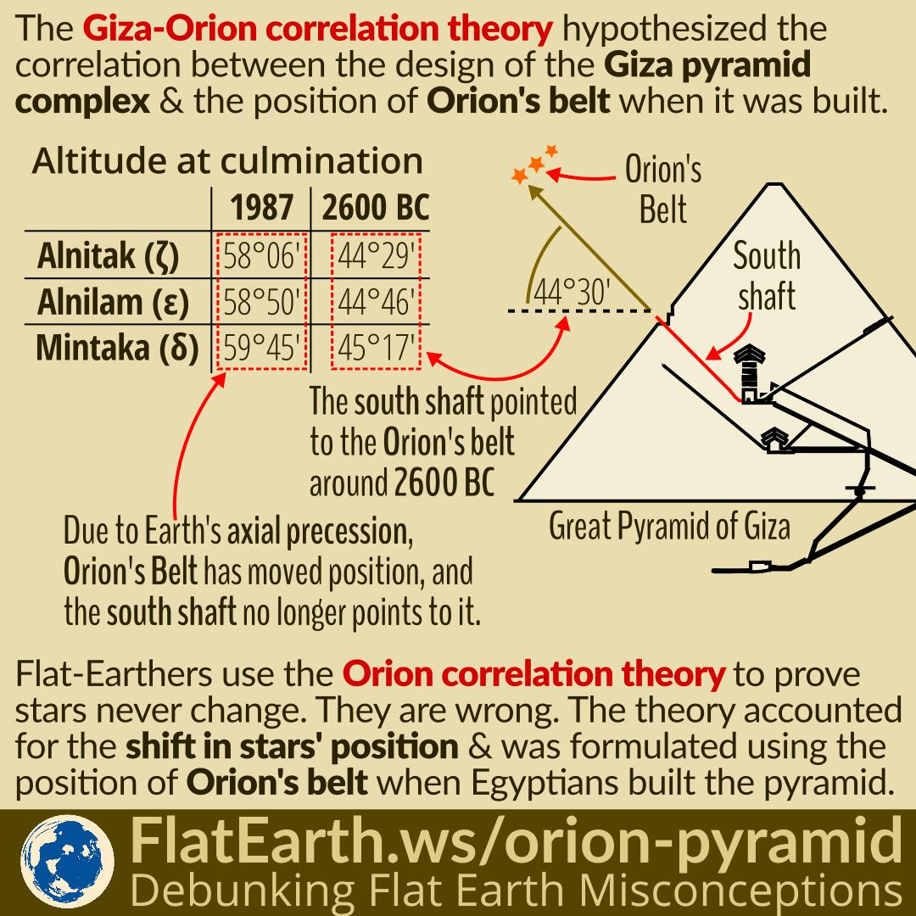
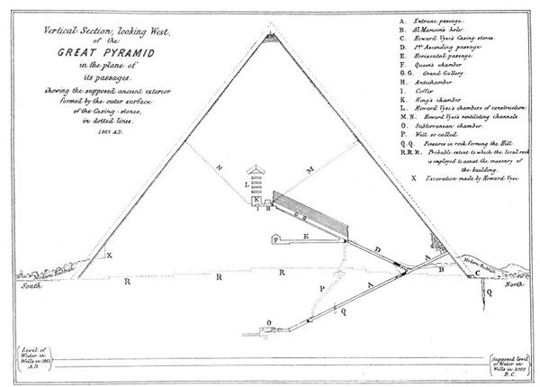
Orion’s Belt

Slide 12
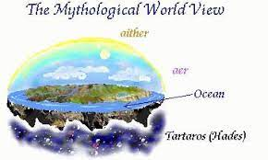
Ancient Greek Cosmology:
The Greeks developed various cosmological models. Anaximander proposed a cylindrical Earth suspended in space, while Pythagoras suggested a spherical Earth.
Plato and Aristotle described a geocentric universe, with Earth at the center and the celestial bodies orbiting around it in concentric spheres.
The philosopher Democritus proposed an atomic theory, suggesting that the universe consists of indivisible particles called atoms.
The Greeks created the first scientific cosmology.

Slide 13
Greek Mythology
In the beginning – chaos
Then from void – Night and Erebus (unknowable place where death dwells)
Eros (Love) was born – beginning of order.
Then, night and day followed by Gaea (Earth).
Erebus slept with Night giving birth to Aether and Day.
Night produced Doom, Fate, Death, Sleep, Dreams, Nemesis, and others.
Gaea gave birth to Uranus, the heavens.
Uranus became Gaea’s mate covering her on all sides.
They produced: three Cyclops, three Hecatoncheires, and twelve Titans.
And the story continues …Uranus was grandfather to Zeus https://www.physics.umd.edu/courses/Phys117/Liberati/Support/cosmology.pdf
https://www.britannica.com/topic/Uranus-mythology

Slide 14
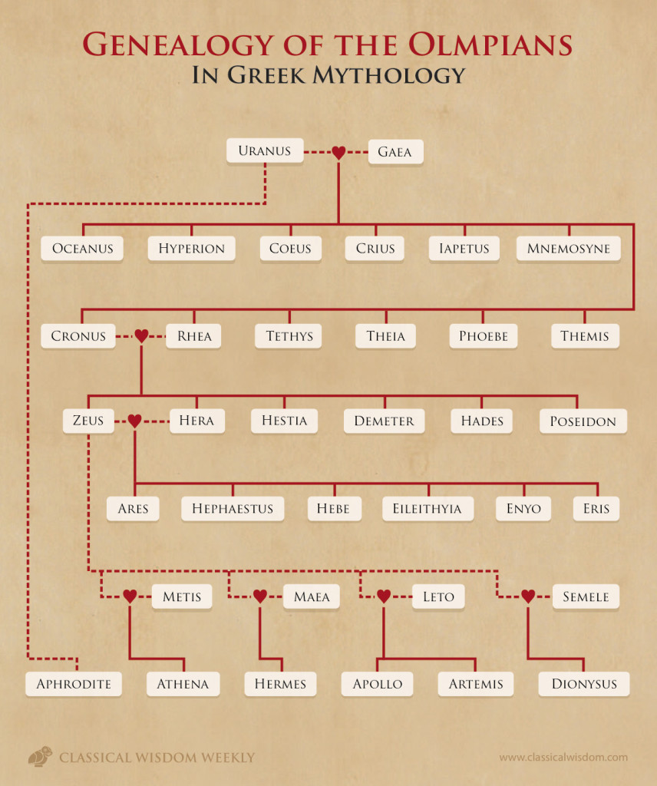
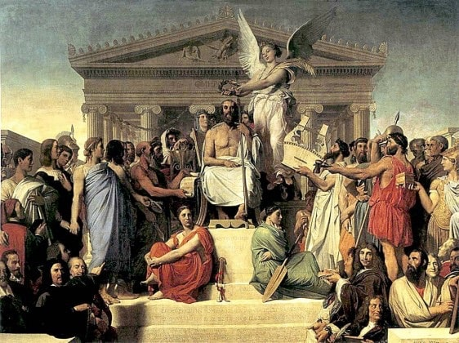
The Gods of Mount Olympus
https://thehistoryjunkie.com/mount-olympus-gods-facts/
https://www.greecehighdefinition.com/blog/2019/3/13/the-genealogy-of-the-titans-of-greek-mythology-7kdh9-3xhxs

Slide 15
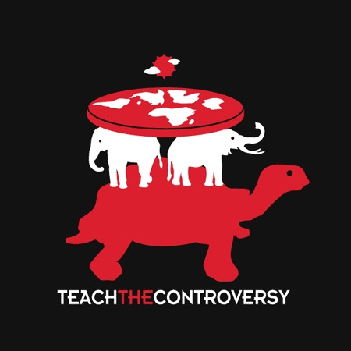
Chinese Cosmology:
Chinese cosmology was influenced by Daoist and Confucian philosophies.
The concept of Yin and Yang represented opposing but complementary forces in the universe.
The Chinese believed in a spherical Earth surrounded by concentric celestial spheres and viewed the cosmos as a harmonious and balanced system.
The Chinese account differs slightly in that they speak of a creator goddess who exists prior to the World Turtle.
This goddess, Nuwa, cuts the legs off of the Turtle and uses them to prop up the sky. This action was necessary after another deity referred to as Gong Gong caused damage to the Buzhou Mountain that originally had been responsible for the job.

Slide 16
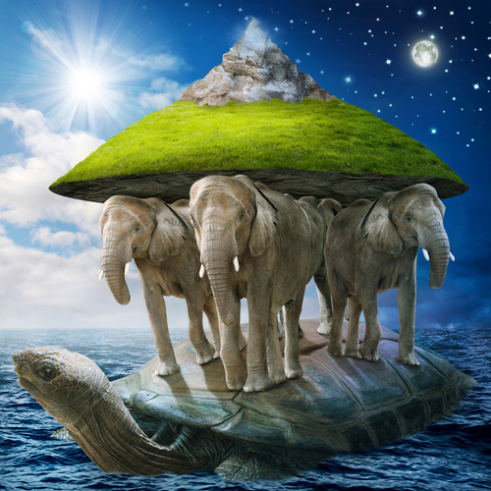
Hindu Cosmology:
Hindu cosmology is rooted in the sacred texts, such as the Vedas and Puranas.
The ancient Hindus believed in a cyclical universe with periods of creation, preservation, and destruction.
The cosmos is visualized as an infinite series of universes within multiple realms, each governed by different gods and deities.
The concept of reincarnation is central to Hindu cosmology, with souls moving through various births until they attain moksha (liberation).
In Hindu mythology, the earth is supported by four elephants standing on the back of a turtle

Slide 17
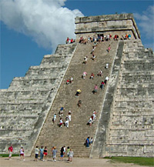
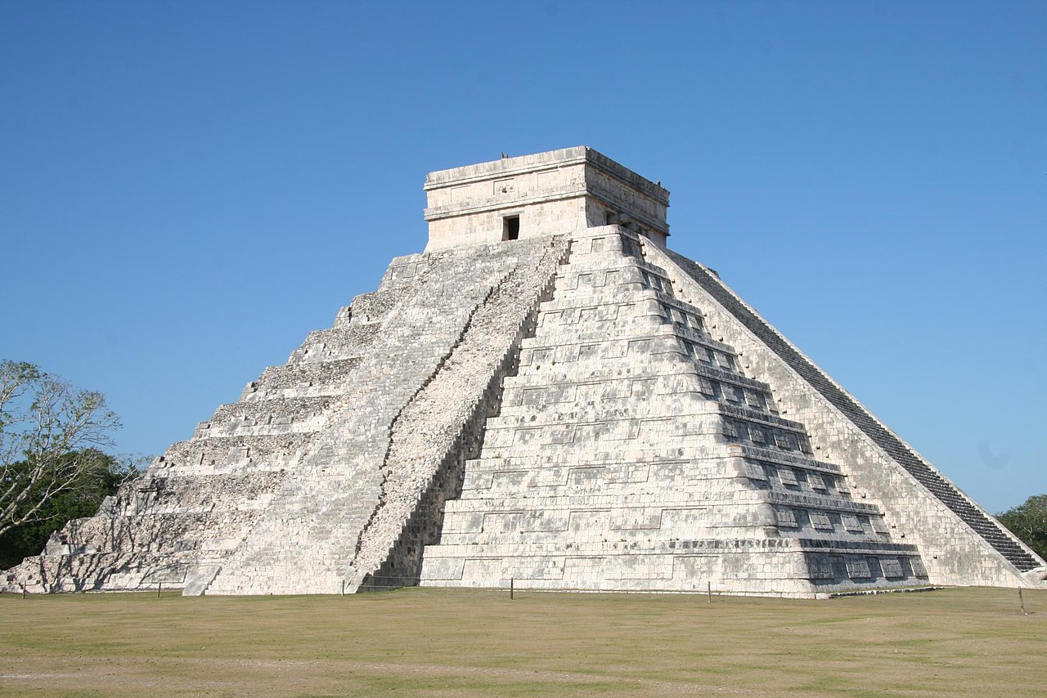
Mayan Cosmology:
The Maya developed a complex cosmology with a focus on the movement of celestial bodies.
They observed and recorded the positions of the sun, moon, and planets and created calendars to track celestial events.
The Maya believed in a multilayered universe with different realms inhabited by gods, ancestors, and humans.
Chichén Itzá, Pyramid of Kukulkán
https://annex.exploratorium.edu/ancientobs/chichen/HTML/castillo.html

Slide 18
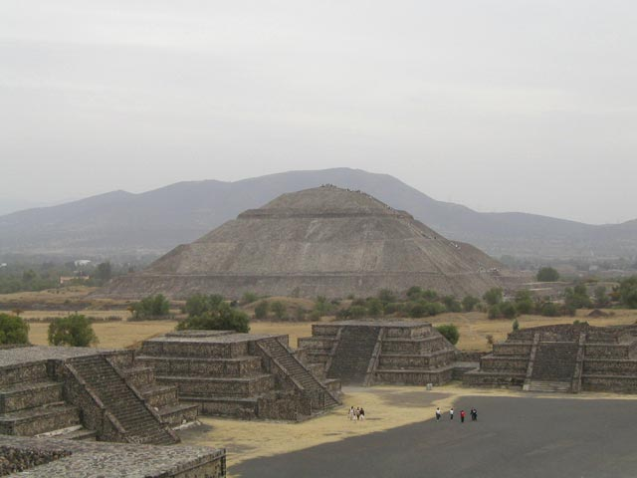
Aztec Cosmology:
The Aztecs had a complex cosmological belief system influenced by earlier Mesoamerican civilizations.
They perceived the universe as a series of cosmic levels, with Earth as the central plane.
The movement of celestial bodies, especially the sun and moon, played a significant role in their religious ceremonies and rituals. The Sun, Moon, and other celestial bodies were deities connected to important aspects of Aztec life and rituals.
The Aztecs believed in a cycle of creation and destruction of the cosmos, with the belief that past worlds had been destroyed by catastrophes. The concept of "Ollin" symbolized the idea of constant change and transformation, essential in their understanding of the cosmos.

Slide 19
Native American Cosmologies:
Native American cultures have diverse cosmologies reflecting their unique spiritual beliefs and practices.
Many Native American tribes view the Earth as a living entity, and celestial bodies are often regarded as significant in guiding their daily lives and spiritual rituals.
The Lakota Sioux, for example, believe in the Star Nation, where the spirits of ancestors reside among the stars.
The Navajo people have intricate sky deities and constellations that play a crucial role in their ceremonial traditions.
Turtle Island (Native American folklore) - 1680, Jasper Danckaerts documented the version of this story as it is told by the Iroquois, "Lenape" myth

Slide 20
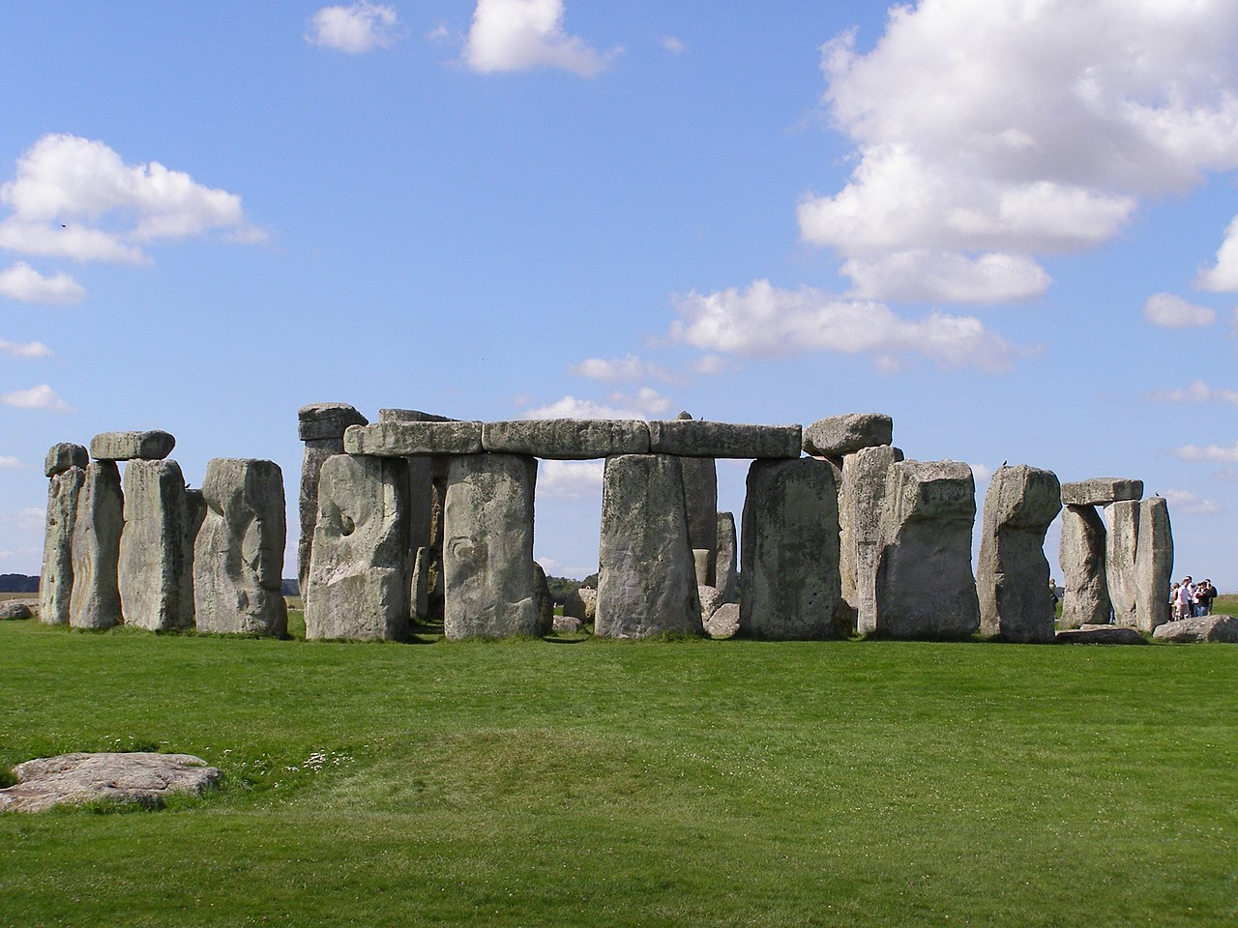
Celtic Cosmology:
Celtic cosmology was shaped by the religious beliefs of ancient Celtic tribes in Europe.
They saw the world as interconnected and animated by spirits, gods, and natural forces.
The celestial bodies, such as the sun, moon, and stars, were regarded as symbols of divine powers and cycles of nature.
The cosmos was perceived as a vast web of interconnected energies and cosmic rhythms.
https://www.digitalmedievalist.com/opinionated-celtic-faqs/stonehenge/

Slide 21
Other Cultures
Also see The Creation of the Universe at Norse Mythology for Smart People: https://norse-mythology.org/tales/norse-creation-myth/
  Africa is a diverse continent with numerous cultures, each with its unique cosmological beliefs.
  Many African cultures have creation myths and stories that explain the origins of the universe and humanity.
  The sky and celestial bodies often held spiritual significance, guiding agricultural practices and rituals.
  Ancestor veneration and spirits of the natural world played a crucial role in African cosmologies.
Pacific Islander Cosmologies:
  Indigenous peoples of the Pacific Islands had cosmologies deeply tied to their relationship with the ocean and land.
  The celestial bodies, winds, and ocean currents were essential for navigation and understanding seasonal changes.
  Many cultures had stories of celestial beings, ancestors, and deities responsible for creating the world and maintaining harmony.
.

Slide 22
Common themes IN cultural creation stories
https://list25.com/25-creation-stories-from-around-the-world/
The world and universe were created by one or more divine beings, gods, or forces.
Creation emerges out of chaos, nothingness, a void, or primordial waters/ocean. There is often a sense of ordering and separating things from primordial chaos.
Creation occurs in stages or steps, such as separating land from water, creating plants and animals, and finally humanity.
Creation is purposeful rather than random, reflecting intelligence, will or intent.
Humans hold a special place and role in creation as the pinnacle, the bridge between the divine and earthly, or made in the image of the divine.
Nature and the elements like sky, earth, water, sun, moon are personified or divinized.
The act of creation is holy, paradigmatic, and establishes cosmic order and natural cycles of time.
Creation stories provide an explanation for the origin and purpose of humanity, the world, and life.

Slide 23
How did different cultures describe the stars, planets, Earth and sky?
Ancient Greeks saw constellations as representations of their myths and gods. They believed the Earth was stationary at the center of the revolving cosmos.
Ancient Chinese saw constellations as symbols of elements of nature, mythology, and agriculture. They viewed the sky as a celestial sphere surrounding a flat Earth.
The Aztecs believed the Earth was the monstrous creature Cipactli, floating in the primal waters. The sky had 13 layers, and stars were brilliant departed warriors.
The Norse saw the Earth as a flat disc surrounded by the ocean. The sky was a dome holding up the tree of life Yggdrasil, with stars as glowing orbs.
Ancient Egyptians saw the sky as the heavenly ocean holding the sun and stars. They believed the Earth was flat and dry, surviving on the celestial waters.
The Babylonians mapped the motions of planets, stars, and constellations in great detail, keeping records of astronomical observations.
The Maya viewed the sky and celestial bodies as critical to their calendar systems and cosmology, including creation myths.
In Hindu cosmology, the sky was considered the realm of the gods. The Earth consisted of seven concentric continents floating in the cosmic ocean.

Slide 24
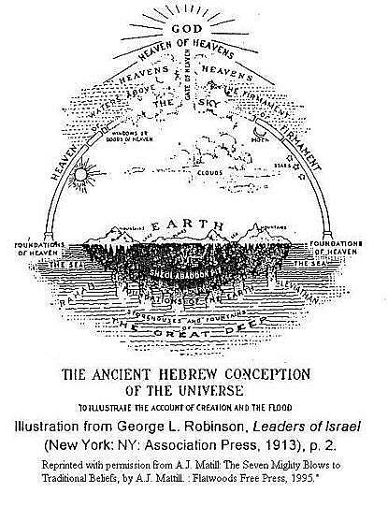
Summary
So in summary, common themes are emergence from chaos, divine creation, purpose and order, humanity's special role, personification of nature, and existential explanations about origins. But the details vary greatly between cultures and traditions.

Slide 25
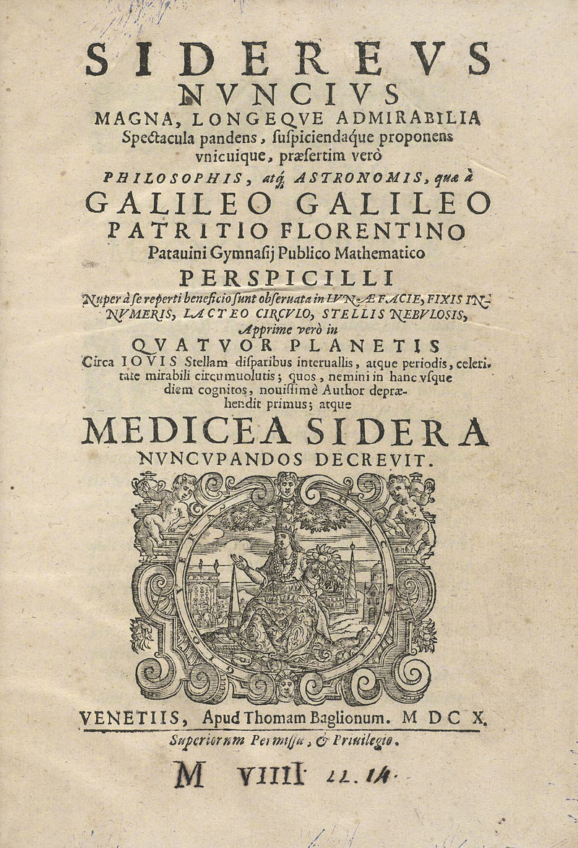
https://www.academia.edu/45630836/COSMOLOGY_FOR_THE_CURIOUS_SPRINGER
https://www.youtube.com/watch?v=XtVl0jOkTPQ&t=174s

